Slide 1
COMP IV

Slide 2
Course Info
Dr. Yelena Rykalova
Yelena_Rykalova@uml.edu
Note: please include Class number and Section in your email
Olsen 220b
Office hours: MW 2 – 3:45 pm
Discussion Group: comp-iv-fall-2017@googlegroups.com
TAs

Slide 3
Grading Policy
70% Weekly Programming Assignments
18% 2-4 Quizzes
8% Final portfolio
4% Classroom/discussion group participation
5 extra points Pop quizzes

Slide 4
Assignments
PS0 – PS7
PSX
Portfolio
http://www.cs.princeton.edu/courses/archive/fall13/cos126/info.html

Slide 5
SFML
SFML Simple and Fast Multimedia Library
SFML provides a simple interface to the various components of your PC, to ease the development of games and multimedia applications. It is composed of five modules: system, window, graphics, audio and network.
SFML has official bindings for the C and .Net languages. And thanks to its active community, it is also available in many other languages such as Java, Ruby, Python, Go, and more.
With SFML, your application can compile and run out of the box on the most common operating systems: Windows, Linux, Mac OS X and soon Android & iOS.

Slide 6
OOP
Object-oriented programming (OOP) is a programming language model organized around objects rather than "actions" and data rather than logic
OOP provides the ability to design an “object”, which ties together both properties and behaviors into a self-contained, reusable package
Programs are written in a more modular fashion:
easier to write and understand
provides a higher degree of code-reusability
Objects provide a more intuitive way to work with data by defining how we interact with the objects, and how they interact with other objects

Slide 7
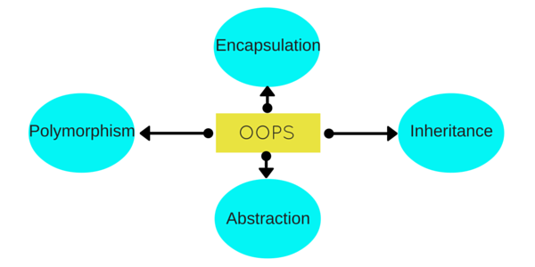
OOP (major principles)

